Slide 1
ALL
IT’S
God
ABOUT

Slide 2
“whatever you do, do it all for the glory of God.” 1 Corinthians 10:31 New Living Translation

Slide 3
LESSONS
Crook
FROM A

Slide 4
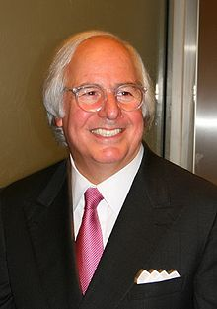
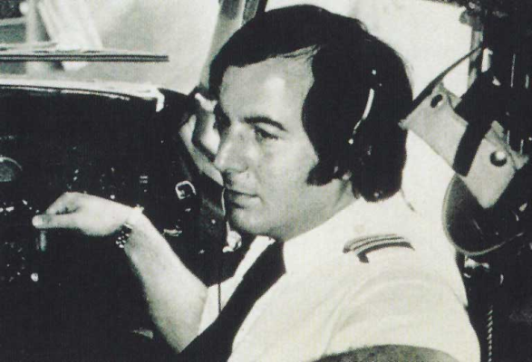

Slide 6
1
FAITH REQUIRES ACTION

Slide 7
“The master commended the dishonest manager because he had acted shrewdly. For the people of this world are more shrewd in dealing with their own kind than are the people of the light. I tell you, use worldly wealth to gain friends for yourselves, so that when it is gone, you will be welcomed into eternal dwellings.
Luke 16:8-9 New Living Translation

Slide 8
But there is going to come a time of testing at the judgment day to see what kind of work each builder has done. Everyone’s work will be put through the fire to see whether or not it keeps its value. If the work survives the fire, that builder will receive a reward. But if the work is burned up, the builder will suffer great loss. The builders themselves will be saved, but like someone escaping through a wall of flames.” 1 Corinthians 3:13-15 New Living Translation

Slide 9
“Don’t store up treasures here on earth, where they can be eaten by moths and get rusty, and where thieves break in and steal. Store your treasures in heaven, where they will never become moth-eaten or rusty and where they will be safe from thieves. Wherever your treasure is, there your heart and thoughts will also be.” Matthew 6:19-22 New Living Translation

Slide 10
Handle Money, Use your Gifts, Suffer For Jesus, Treat Other Christians, Handle Authority Spend Your Time, Share Your Faith Handle Temptations, Control Sinful Nature Anticipate the Rapture Submit to Church Leadership

Slide 12
2
BE RESPONSIBLE WITH WHAT YOU HAVE

Slide 13
“Whoever can be trusted with very little can also be trusted with much, and whoever is dishonest with very little will also be dishonest with much. So if you have not been trustworthy in handling worldly wealth, who will trust you with true riches?” Luke 16:10-11 New Living Translation

Slide 14
“You may possess much,
but you don’t own anything.” Dr Warren Wiersbe

Slide 15
WE ARE MANAGERS
Creation, Family, gifts, talents, opportunities money…

Slide 16
“Inconsistent giving results in inconsistent living.” Dr Rick Warren

Slide 17
“So our aim is to please him always, whether we are here in this body or away from this body. For we must all stand before Christ to be judged. We will each receive whatever we deserve for the good or evil we have done in our bodies.” 2 Cor. 5:10 New Living Translation

Slide 19
3
LET GOD BE YOUR MASTER NOT MONEY

Slide 20
“No one can serve two masters.
Either you will hate the one and love the other,
or you will be devoted to the one
and despise the other.
You cannot serve both God and money.” Luke 16:13 New Living Translation

Slide 21
“For the love of money is a root of all kinds of evil.” 1 Timothy 6:10 New Living Translation

Slide 22
“The purpose of tithing is to teach you to always put God first in your life.” Deuteronomy 14:23 Living Bible

Slide 23
-Act on your faith How much are you investing for eternity?
-Be Responsible with What You Have Now Can God trust You with more?
-Let God Be the Master of Your Life Does God really have first place in your life?

Slide 24
LESSONS
Crook
FROM A

Slide 25
ALL
IT’S
God
ABOUT

