Slide 2
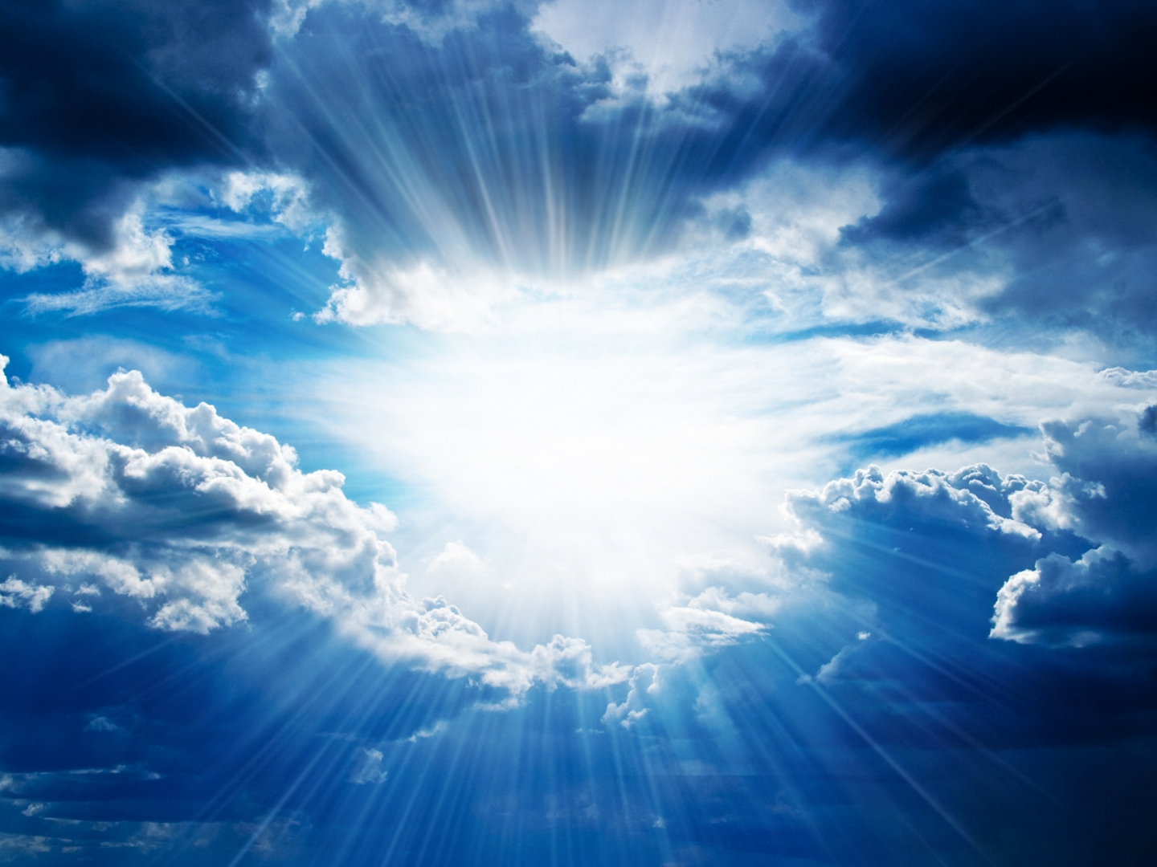
E N C O U N T E R
I N C A N A A N

Slide 3
https://www.youtube.com/watch?v=gWsCDKfWEaU

Slide 4
ABRAM
LOT

Slide 5
UR

Slide 6
CANAAN
UR

Slide 7
CANAAN
UR
EGYPT

Slide 8
CANAAN
SODOM
UR
EGYPT

Slide 9
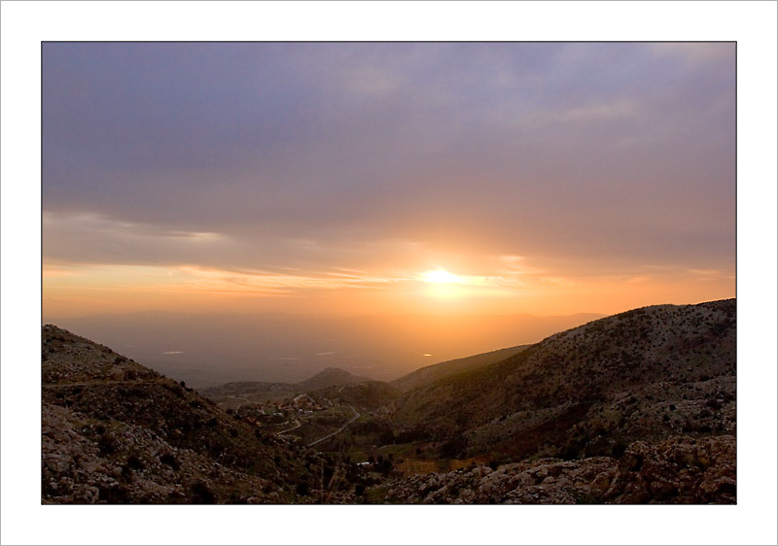

Slide 10
GENESIS 13:9 NEW LIVING TRANSLATION
Take your choice….

Slide 11
E N C O U N T E R
I N C A N A A N

Slide 12
MAKE A TOTAL COMMITMENT
The Lord had said to Abram, “Leave your native country, your relatives, and your father’s family, and go to the land that I will show you…. So Abram departed as the Lord had instructed, and Lot went with him.
GENESIS 12:1,4 new living translation
1

Slide 13
GENESIS 13:8-9 NEW LIVING TRANSLATION
Finally Abram said to Lot, “Let’s not allow this conflict to come between us or our herdsmen. After all, we are close relatives! ⁹ The whole countryside is open to you. Take your choice of any section of the land you want, and we will separate. If you want the land to the left, then I’ll take the land on the right. If you prefer the land on the right, then I’ll go to the left.”

Slide 14
GENESIS 13:14-16 NEW LIVING TRANSLATION
After Lot had gone, the Lord said to Abram, “Look as far as you can see in every direction—north and south, east and west. ¹⁵ I am giving all this land, as far as you can see, to you and your descendants as a permanent possession.¹⁶ And I will give you so many descendants that, like the dust of the earth, they cannot be counted!

Slide 15
THINK OF THE LONG-TERM IMPACT
2
Lot took a long look at the fertile plains of the Jordan Valley in the direction of Zoar. The whole area was well watered everywhere, like the garden of the Lord or the beautiful land of Egypt.
GENESIS 13:10 new living translation

Slide 16
JAMES 1:14 NEW LIVING TRANSLATION
“Temptation comes from our own desires, which entice us and drag us away.”

Slide 18
LISTEN TO YOUR WAKE-UP CALLS
3
“they also captured Lot-Abram’s nephew who lived in Sodom-and carried off everything he owned.”
GENESIS 14:12 new living translation

Slide 19
2 PETER 2:7 NEW LIVING TRANSLATION
“But God also rescued Lot out of Sodom because he was a righteous man who was sick of the shameful immorality of wicked people around him.”

Slide 20
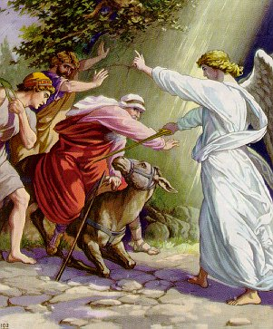

Slide 21
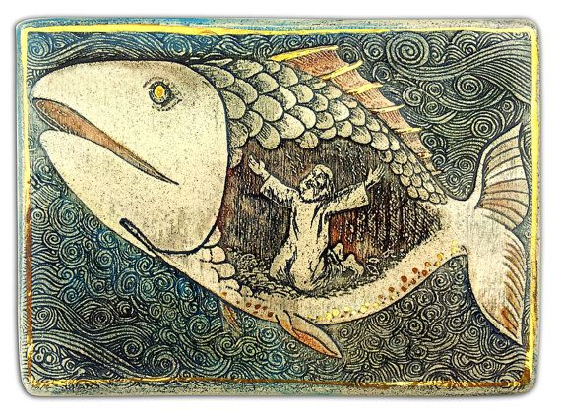

Slide 22
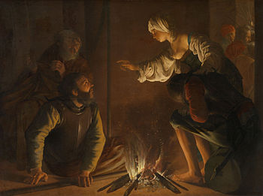

Slide 23
PREFER THE COMPANY OF BELIEVERS
4
“they also captured Lot-Abram’s nephew who lived in Sodom-and carried off everything he owned.”
GENESIS 14:12 new living translation

Slide 24
HEBREWS 10:25 NEW LIVING TRANSLATION
And let us not neglect our meeting together, as some people do, but encourage one another, especially now that the day of his return is drawing near.

Slide 25
1 CORINTHIANS 5:9-10
NEW LIVING TRANSLATION
When I wrote to you before, I told you not to associate with people who indulge in sexual sin. But I wasn’t talking about unbelievers who indulge in sexual sin, or are greedy, or cheat people, or worship idols. You would have to leave this world to avoid people like that.

Slide 26
MATTHEW 5:13-14
NEW LIVING TRANSLATION
“You are the salt of the earth. But what good is salt if it has lost its flavor? Can you make it salty again? It will be thrown out and trampled underfoot as worthless. “You are the light of the world—like a city on a hilltop that cannot be hidden.”

Slide 27
DON’T RATIONALIZE SIN
5
“That evening the two angels came to the entrance of the city of Sodom. Lot was sitting there, and when he saw them, he stood up to meet them.” GENESIS 19:1 new living translation

Slide 28
1 KINGS 18:21 LIVING BIBLE
How long will you waver between two opinions? If the Lord is God, follow Him! But if Baal is God, then follow Him!

Slide 29
Living in two worlds will only leave you miserable and compromised. Choose to live a life of integrity, living righteously. Whatever it costs you on earth, God will make up in heaven.

